Slide 1
Detecting Phishing Websites using Machine Learning
Guided By:
Prof. L. Gowri
Presented By:
Siddharthan S,
Bachelor of Computer Applications,
Sastra University,
Thanjavur

Slide 2
INTRODUCTION
Phishing websites pose a growing risk to online security.
Machine learning algorithms are essential for proactive identification of phishing sites.
The study focuses on using machine learning to bolster cybersecurity and protect users from evolving malicious tactics.
Objective is to implement measures that leverage machine learning for real-time detection, mitigating risks posed by phishing websites.

Slide 3
PROBLEM STATEMENT
Phishing threats surpass traditional identification methods, demanding a proactive solution.
Research focuses on leveraging machine learning for robust URL feature analysis.
Goal is to differentiate effectively between legitimate and phishing websites.
Aiming for an advanced model to enhance overall cybersecurity.

Slide 4
ABSTRACT
Investigation into machine learning for phishing website detection via URL features.
Focus on distinguishing between legitimate and malicious sites.
Evaluation of decision trees, random forests, and deep learning for accurate detection.
Contributes to cybersecurity measures by enhancing phishing detection capabilities.

Slide 5
OBJECTIVE
Development and assessment of machine learning algorithms (decision trees, random forest, deep learning) for proactive phishing detection.
Evaluation of model effectiveness in distinguishing between legitimate and malicious sites.
Goal is to enhance online security and contribute insights to the evolving field of cybersecurity.

Slide 6
SYSTEM DESIGN (Architecture Diagram)
Phase 1
Phase 3
Phase 4
DATA COLLECTION
TRAINING (RANDOM FOREST)
BEST SUITED MACHINE LEARNING ALGORITHM
TRAINING SET
TESTING SET
Phase 2
PRE-PROCESSING
SPLITTING THE DATASET
RESULT

Slide 7
METHODOLOGY
Dataset collection: Effective machine learning starts with acquiring a quality dataset, where data quantity and quality strongly influence model performance. Techniques such as web scraping and manual interventions can be employed.
Preprocessing: Data pre-processing is crucial in machine learning for optimal results. It involves applying transformations to the raw data before feeding it into the algorithm, essentially converting it into a clean dataset.

Slide 8
METHODOLOGY
Data Splitting: Data splitting is vital to prevent overfitting in machine learning. This project employs the 70:30 rule, with 70% of the dataset for model training and the remaining 30% for testing.
Machine Learning Algorithms: After splitting the dataset, we train the model using machine learning algorithms. This project employs random forest, decision tree, and support vector machine with hyperparameter tuning
Model Evaluation: The final phase of machine learning determines the "best fit" algorithm for a given dataset and problem. In this project, logistic regression outperforms other algorithms, providing the highest accuracy.

Slide 9
SYSTEM REQUIREMENTS
HARDWARE REQUIREMENTS:
System : Intel Pentium IV 2.80 GHz.
Monitor : LED.
Mouse : Logitech.
Ram : 4.00 GB or above 4.00 GB
Hard Disk : 250 GB
SOFTWARE REQUIREMENTS:
Operating system : Windows 7, Ubuntu
Language : Python 3

Slide 10
DATA FLOW DIAGRAM
INPUT
Input: Users enter URLs to check for phishing.
Data Preprocessing: Clean and remove irrelevant data from user input.
Feature Extraction: Extract relevant URL features like domain, IP, and SSL.
Phishing Detector: Check the URL using features to detect phishing, using algorithms like decision trees and deep learning.It determine if a website is phishing based on the model's output.
Output: Provide users with the final indication of whether the website is phishing or not.
PREPROCESSING
FEATURE EXTRACTION
(PHISHING DETECTOR) DETECTION/CLASSIFICATION
(OUTPUT) PHISHING WEBSITE DETECTION

Slide 11
APPROACH
Below mentioned are the steps involved in the completion of this project:
• Collect dataset containing phishing and legitimate websites from the open source platforms.
• Write a code to extract the required features from the URL database.
• Analyze and preprocess the dataset by using EDA techniques.
• Divide the dataset into training and testing sets.
• Run selected machine learning and deep neural network algorithms like SVM, Random Forest, Autoencoder on the dataset. • Write a code for displaying the evaluation result considering accuracy metrics.
• Compare the obtained results for trained models and specify which is better.

Slide 12
DATA COLLECTION
• Legitimate URLs are collected from the dataset provided by University of New Brunswick, https://www.unb.ca/cic/datasets/url-2016.html.
• From the collection, 5000 URLs are randomly picked.
• Phishing URLs are collected from opensource service called PhishTank . This service provide a set of phishing URLs in multiple formats like csv, json etc. that gets updated hourly.
• Form the obtained collection, 5000 URLs are randomly picked.

Slide 13
FEATURE SELECTION
• The following category of features are selected:
• Address Bar based Features
• Domain based Features
• HTML & Javascript based Feature
• Address Bar based Features considered are:
• Domian of URL • Redirection ‘//’ in URL
• IP Address in URL • ‘http/https’ in Domain name
• ‘@’ Symbol in URL • Using URL Shortening Service
• Length of URL • Prefix or Suffix "-" in Domain
• Depth of URL

Slide 14
FEATURE SELECTION (CONT.)
• Domain based Features considered are:
• DNS Record • Age of Domain
• Website Traffic • End Period of Domain
• HTML and JavaScript based Features considered are:
• Iframe Redirection • Disabling Right Click
• Status Bar Customization • Website Forwarding
• All together 17 features are extracted from the dataset.

Slide 15
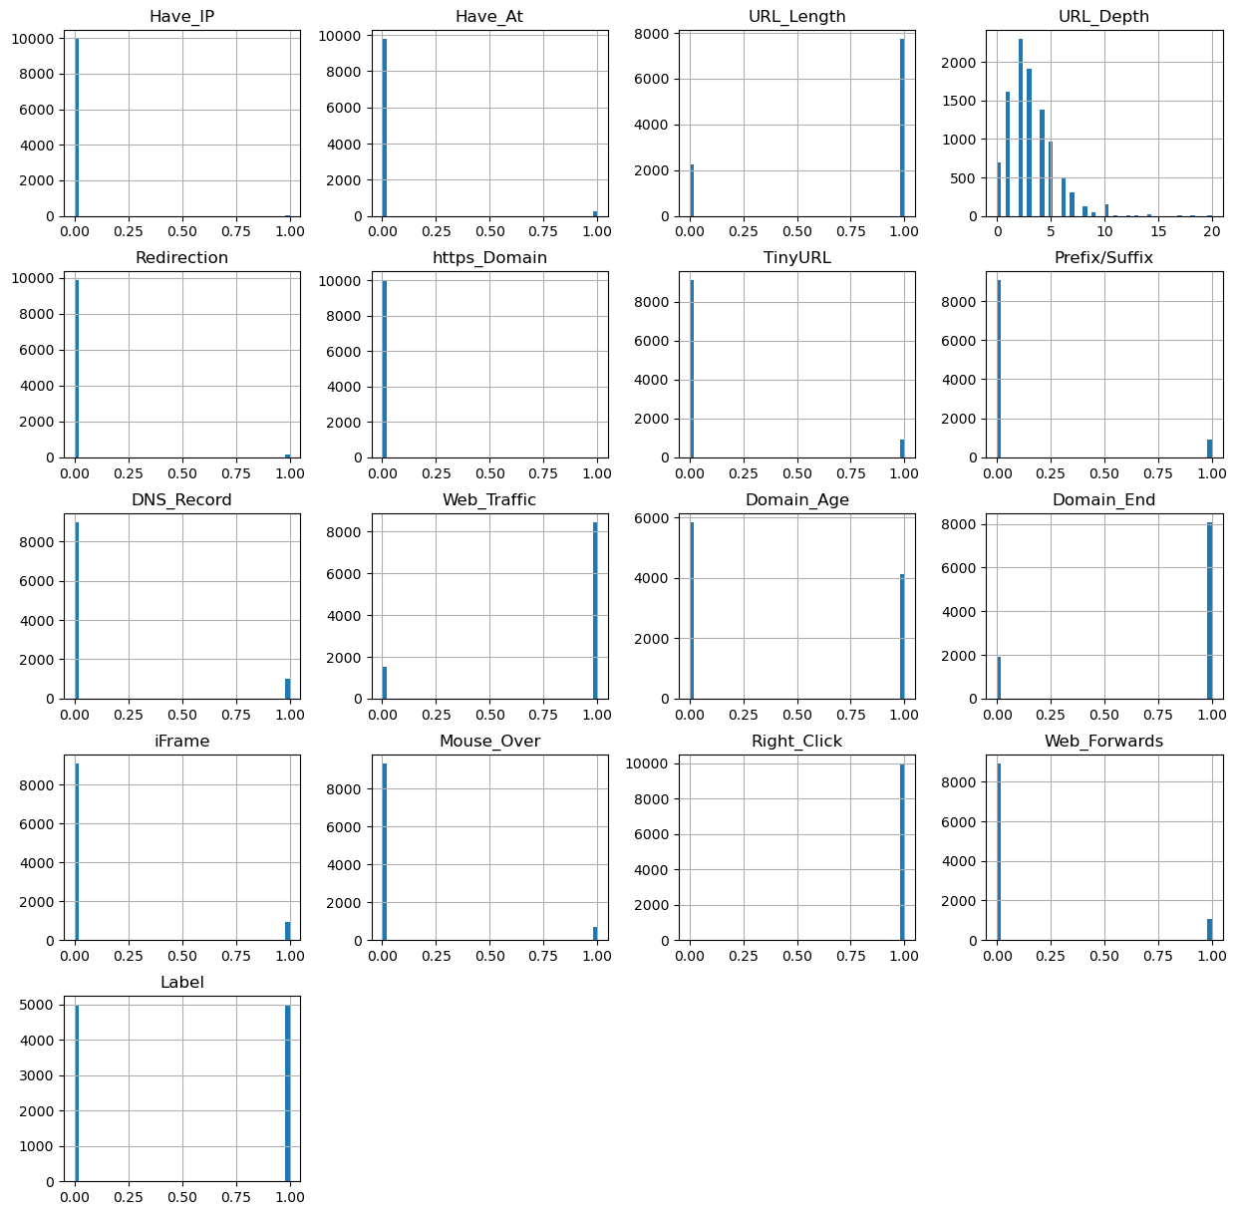
FEATURES DISTRIBUTION

Slide 16
MACHINE LEARNING MODELS
• This is a supervised machine learning task. There are two major types of supervised machine learning problems, called classification and regression.
• This data set comes under classification problem, as the input URL is classified as phishing (1) or legitimate (0). The machine learning models (classification) considered to train the dataset in this notebook are:
• Decision Tree • Random Forest
• Multilayer Perceptrons • XGBoost
• Autoencoder Neural Network • Support Vector Machines

Slide 17
MODEL EVALUATION
• The models are evaluated, and the considered metric is accuracy.
• Below Figure shows the training and test dataset accuracy by the respective models:
 | ML Model | Train Accuracy | Test Accuracy
3 | XGBoost | 0.866 | 0.864
2 | Multilayer Perceptrons | 0.858 | 0.863
1 | Random Forest | 0.814 | 0.834
0 | Decision Tree | 0.810 | 0.826
4 | AutoEncoder | 0.819 | 0.818
5 | SVM | 0.798 | 0.818
• For the above it is clear that the XGBoost model gives better performance. The model is saved for further usage.

Slide 18
NEXT STEPS
• Working on this project is very knowledgeable and worth the effort.
• Through this project, one can know a lot about the phishing websites and how they are differentiated from legitimate ones.
• This project can be taken further by creating a browser extensions of developing a GUI.
• These should classify the inputted URL to legitimate or phishing with the use of the saved model.

Slide 19
THANK YOU

